Slide 1





Musical micro:bit
Teacher lesson guide
Lesson 1

Slide 2
Learning objectives:
To read and interpret a range of algorithms.
To evaluate algorithms.
To write algorithms for a given audience.

Slide 3
Fill the gap
Clap for four beats, rest for four beats.
Create a musical phrase to play in the rest gap.
If you are pointed at, play your musical phrase during the rest.

Slide 4
Complete the algorithm
Forever
IF I am pointed at then
ELSE
Notes:
If I am pointed at then
play my musical phrase
Else
clap for four beats, rest for four beats

Slide 5
Recapping algorithms
What are algorithms?
What algorithms have you written previously?
What forms have your algorithms taken?
Notes:
An algorithm is a set of sequenced instructions, steps or rules for a human to follow to solve a problem or complete a task.
Pupils should identified what the purpose of their previously written algorithms was i.e. what did they allow someone to achieve if followed correctly.
Previous forms could involve written instructions, storyboards, flowcharts, step-by-step instructions, diagrams, etc.

Slide 6
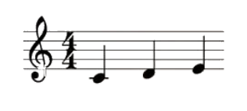
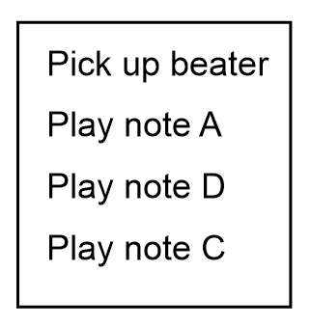
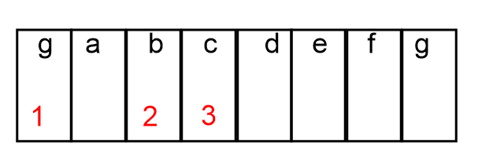
Identifying algorithms
Which of these images do you think are algorithms?
Notes:
All the images can be classified as algorithms because they all give instructions to a human to play music.

Slide 7
Evaluating algorithms
Evaluate each algorithm by identifying what it does well and how it could be improved.
Notes:
Musical notation +ve quick to record instructions, can be used by musicians playing most instruments -ve only people who can read music can use this algorithm.
Written Algorithm +ve easy to understand -ve longer to write out, need to know the notes on the instrument
Image with numbers +ve quick to record, shows user where the notes are -ve can’t record longer pieces of music

Slide 8
Algorithm Evaluation Sheet
For each algorithm identify at least one positive and one negative about it. Remember algorithms should give a sequence set of instructions, steps or rules to human to help them solve a problem or complete a task.

Slide 9
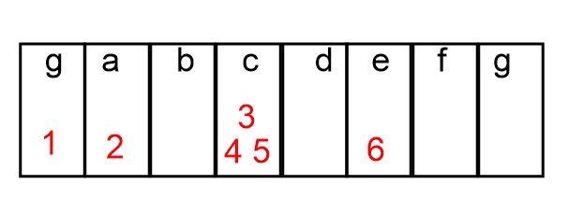
Reading musical algorithms
What instructions is this algorithm giving?
What will be produced by following this algorithm?

Slide 10
Describing musical algorithms
This musical phrase is ascending.
This musical phrase contains six notes.
This musical phrase contains four unique notes.
This musical phrase repeats note c three times.
Notes:
Ascending because the notes increase in pitch from the start to the beginning
The phrase has six notes (g, a, c, c, c, e)
The phrase has four unique notes (g, a, c, e)
In the phrase the note c is played three times

Slide 11
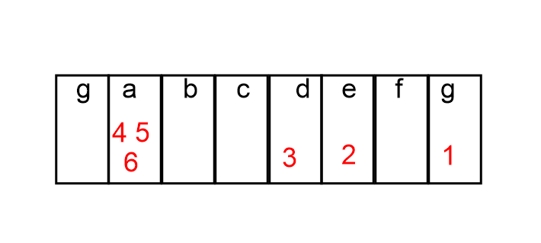
Describing musical algorithms
Is this musical phrase ascending or descending?
How many notes does this musical phrase have?
How many unique notes does this musical phrase have?
Are any notes repeated?
Notes:
Descending because the notes decrease in pitch from the start to the beginning
The phrase has six notes (g, e, d, a, a, a)
The phrase has four unique notes (g, e, d, a)
In the phrase the note a is played three times

Slide 12
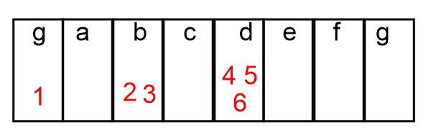
Describing musical algorithms
Is this musical phrase ascending or descending?
How many notes does this musical phrase have?
How many unique notes does this musical phrase have?
Are any notes repeated?
Notes:
Ascending because the notes increase in pitch from the start to the beginning
The phrase has six notes (g,b, b, d, d, d)
The phrase has three unique notes (g, b, d)
In the phrase the note b is played twice and note d is played three times

Slide 13
Composing musical phrases and algorithms
Create three musical phrases:
Each phrase should have 4-6 notes.
Each phrase should have a maximum of 4 unique notes.
Each phrase should have a repeating note.
At least one phrase should be ascending.
At least one phrase should be descending.
Write an algorithm for each phrase for someone who cannot read music.

Slide 14
Evaluating musical phrases and algorithms
Swap algorithms with another pair.
Use their algorithms to play their musical phrases.
Evaluate their work by considering the following:
Do their phrases meet the given criteria?
Are their instructions written for someone who cannot read music?
Are the instructions clear and easy to follow?
Could the algorithm be written with fewer instructions?

Slide 15
Learning objectives revisited:
To read and interpret a range of algorithms.
To evaluate algorithms.
To write algorithms for a given audience.

